Slide 1

Getting Started
Prof. Darrell Long
CSE 13S

Slide 2

Assumptions
You have access to a computer.
You have a virtual machine running Ubuntu 20.04
You have created your account on git.ucsc.edu
You have created a ssh key
You have written at least a simple in a higher-level language program.
You have passed CSE 12.

Slide 3

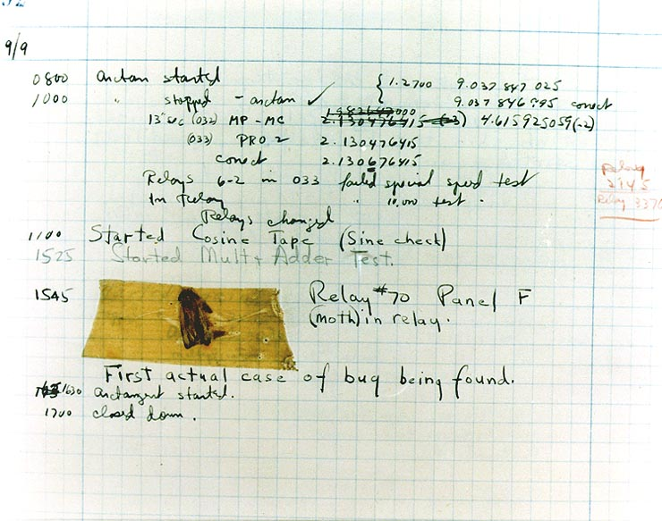
Today’s Tools
RADM Grace Hopper
Created one of the first compilers
Also documented the first real computer bug!
Editor
Compiler
git
Command line

Slide 4
Let’s get you on the virtual machine
We’ll make an ssh key
Make directories
Clone a repository
… And pretty much complete assignment 0

Slide 5
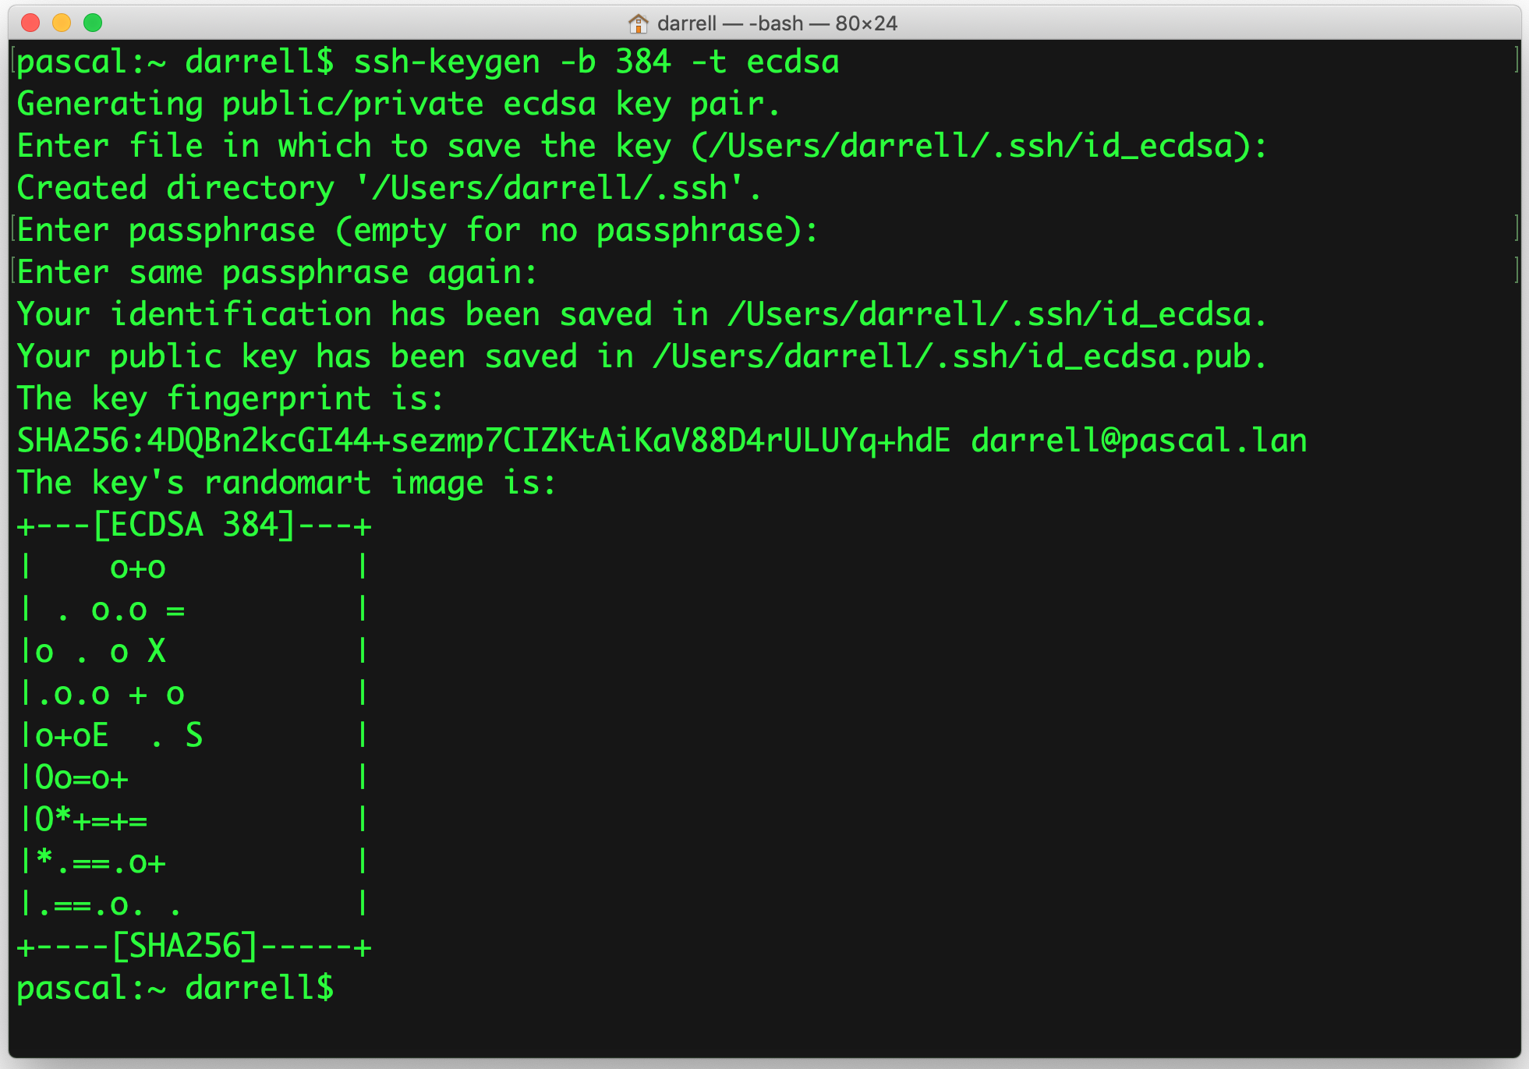
Create an ssh Key

Slide 6
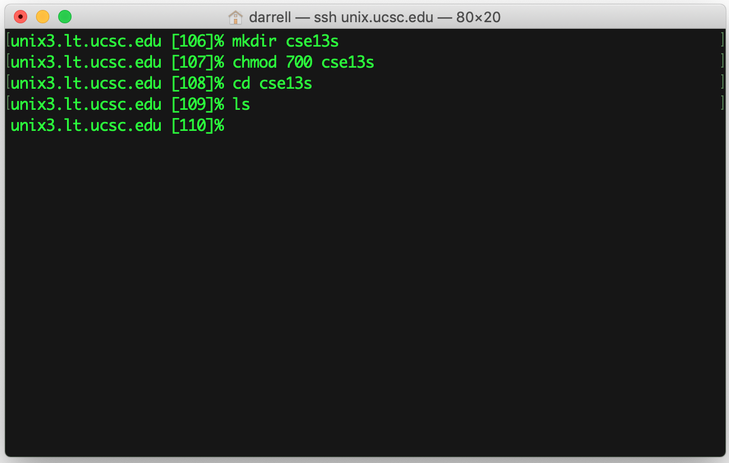
mkdir cse13s
Create the directory
Keep it private
Go to the directory
Anything in it?

Slide 7
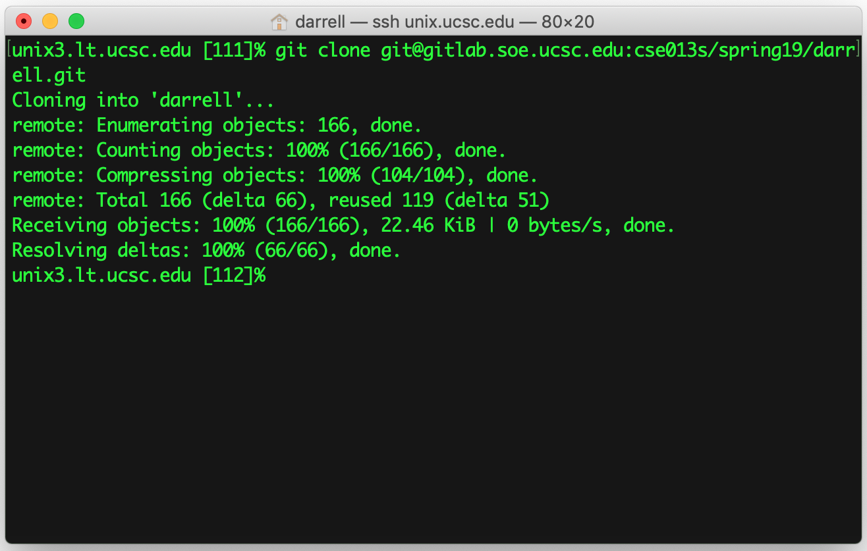
Clone the Respository
This is your CruzID
Use the right term

Slide 8
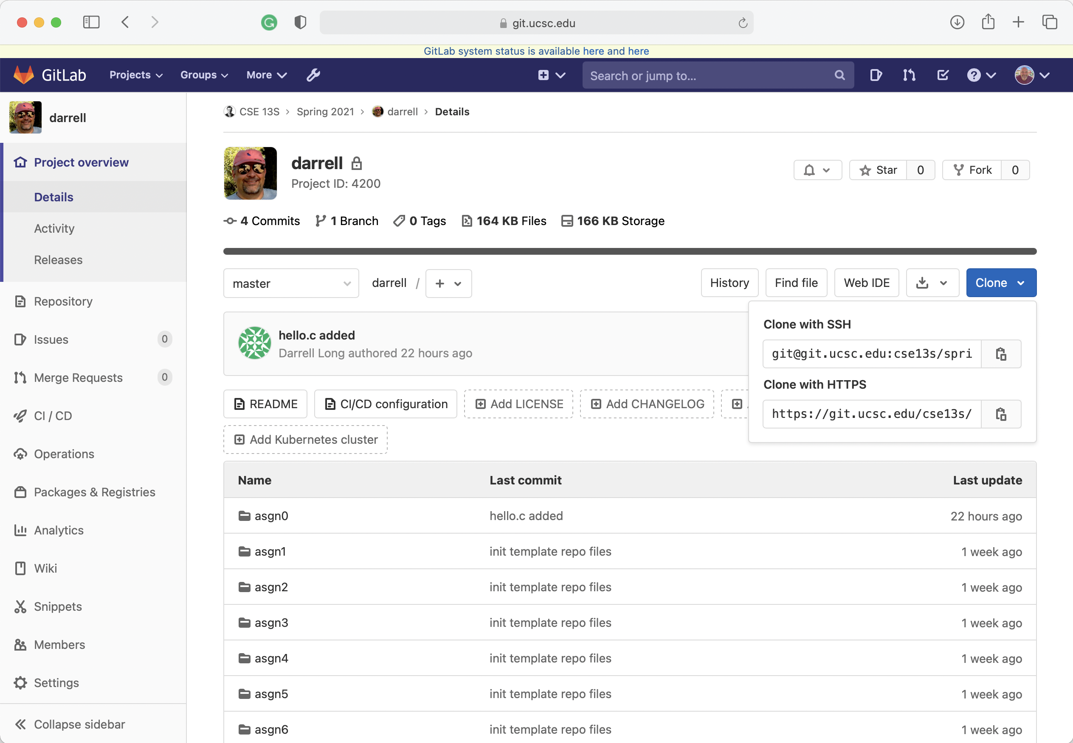
Where did you get that?
Copy this URL

Slide 9
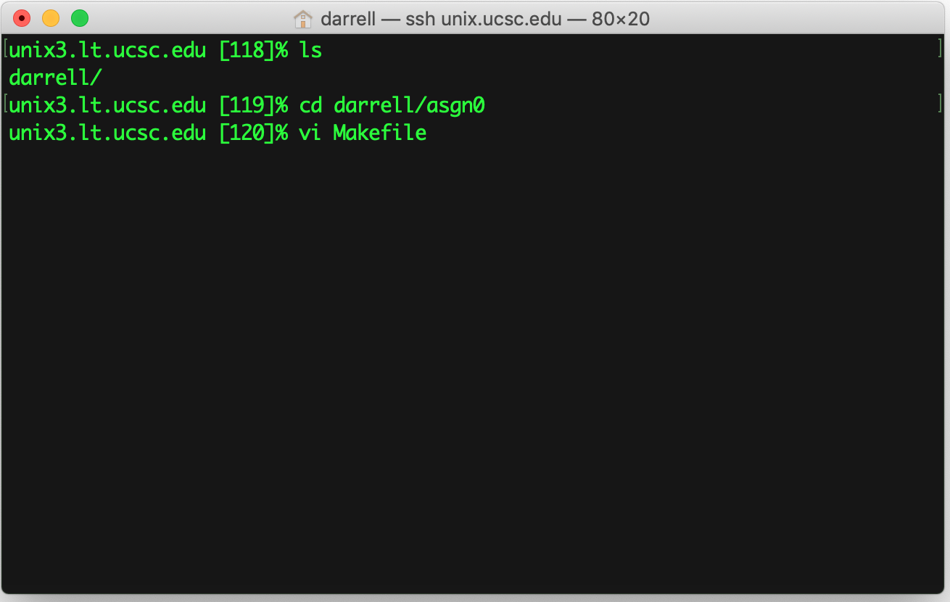
Start Work
Did it work?
Enter the directory
Edit the file

Slide 10
Vi/Vim
The pursuit of knowledge is never-ending. The day you stop seeking knowledge is the day you stop growing
—Brandon Travis Ciaccio
Vi is the standard text editor found on Unix systems.
Vim is an acronym for “Vi IMproved” and is considered a clone of the Vi editor.
Most UNIX systems simply alias “vi” to “vim” so using either one is fine.
Functionally, Vim is almost a proper superset of Vi, thus everything in Vi as also available in Vim.
In general, use Vim when possible as includes built-in support for numerous programming languages and has been ported to a much wider range of OS’s than Vi.
Vim uses two different modes for text editing:
Normal mode (also called command mode)
Insert mode
We will only cover the basics of Vi/Vim to get you started.
If you wish to learn all the nuances of Vi/Vim, you will have to do so yourself.

Slide 11
Normal Mode
The default mode when you open a file in Vim is normal, or command mode.
Commands enable you to move anywhere in the file, perform edits, enter insert mode to add new text, save the file, or exit the file.
Basic cursor movement in normal mode:
h – move cursor left one space.
j – move cursor down one line.
k – move cursor up one line.
l – move cursor right one space.
File related commands:
:wq – save and quit file.
:q! – quit file without saving.
:%s/hello/goodbye/g – replace all instances of “hello” with “goodbye”.
:n – jump to line number n.

Slide 12
Commands
Vim commands can be thought of as a language it and of itself.
For example, in Vim, ‘d’ means to delete, and ‘w’ means a word:
These operations can be combined into the command “diw”.
This reads as “delete in word”, and deletes the word your cursor is in.
You can also combine operations with movement/motion commands (h, j, k, l) and counts:
The command “dl” deletes one character to the right.
The command “3dl” deletes three characters to the right.
This ability to combine operations with motions and counts is what makes Vim so flexible and great for text editing.
Note that Vim is case-sensitive, so make sure you’re using the right casing for your commands.

Slide 13
Insert Mode
Insert mode allows you to add text to a file.
Normal mode is used to navigate and make quick edits to files.
Insert mode is used only to add text.
You should spend most of your time in normal mode.
Insert mode is entered when the key ‘i’ is pressed in normal mode.
You can also enter insert mode with ‘a’, which appends text after the cursor rather than before.
Insert mode is exited when the escape key is pressed.

Slide 14
Basic Vim Cheat sheet
H – move to top of screen
M – move to middle of screen
L – move to bottom of screen.
w – jump forwards to start of word
e – jump forwards to start of word
b – jump backwards to start of word
% – move to matching character (used for braces)
^ – jump to first non-blank character in line
gg – go to first line of document
G – go to last line of document
:wq – save and quit
r – replace a single character
cc – change (replace) entire line
C – change to end of the line
ciw – change in word
u – undo
CTRL+r – redo
. – repeat last command
yy – yank (copy) line into buffer
Y – yank to end of the line
p – paste from buffer
o – open new line below current line

Slide 15
Editors live in your fingers…
The commands are not obvious.
This is not unique to Vim, it is also true for emacs.
It requires practice!
It is a kind of muscle memory, like playing the guitar.
No one thinks “I need to type i now to insert”

Slide 16
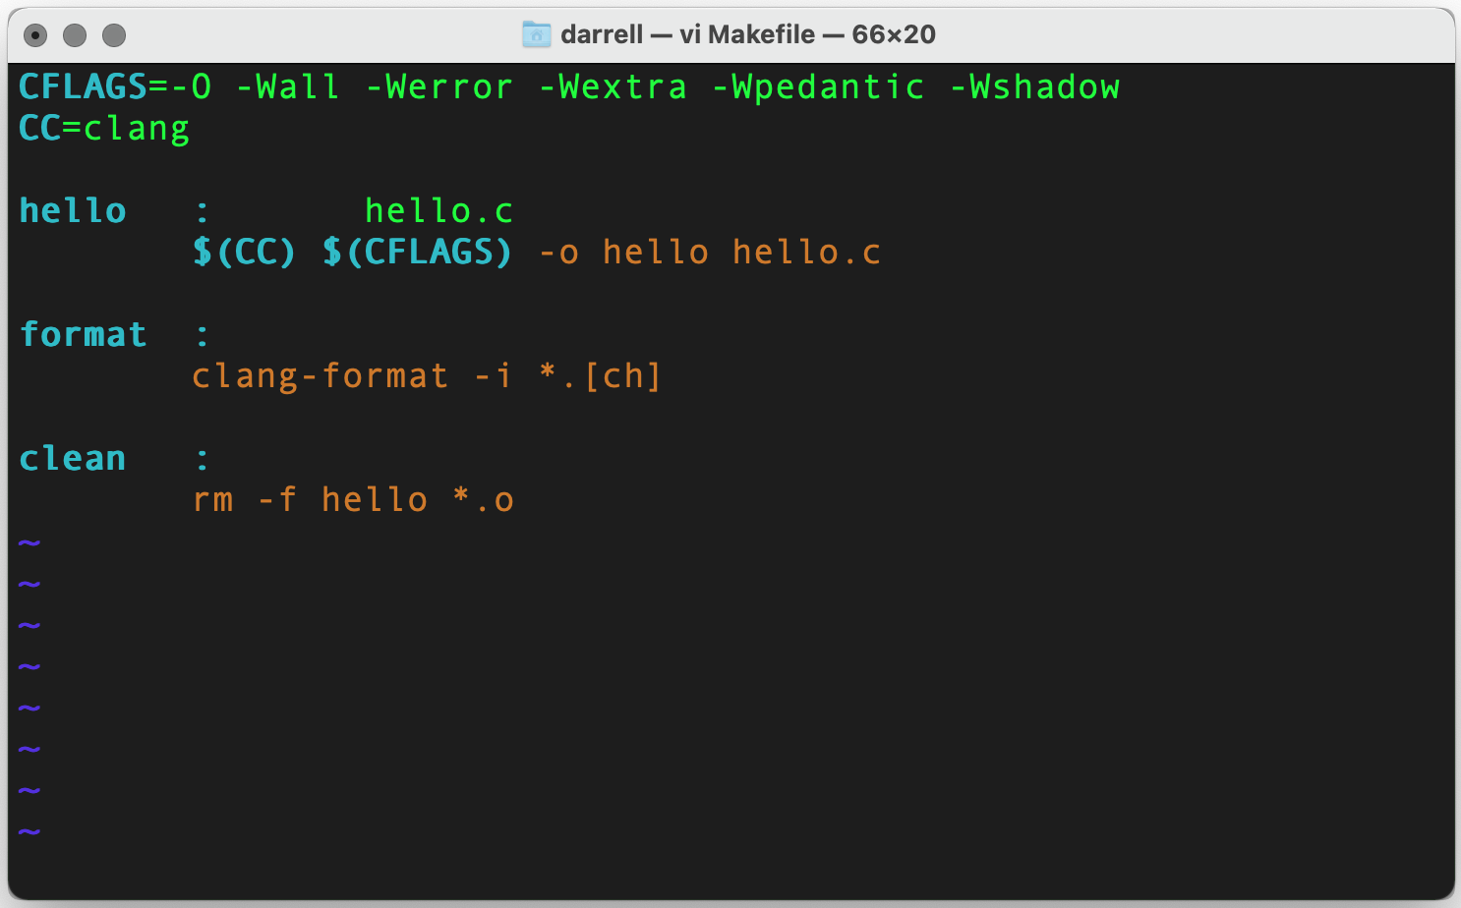
vi Makefile

Slide 17
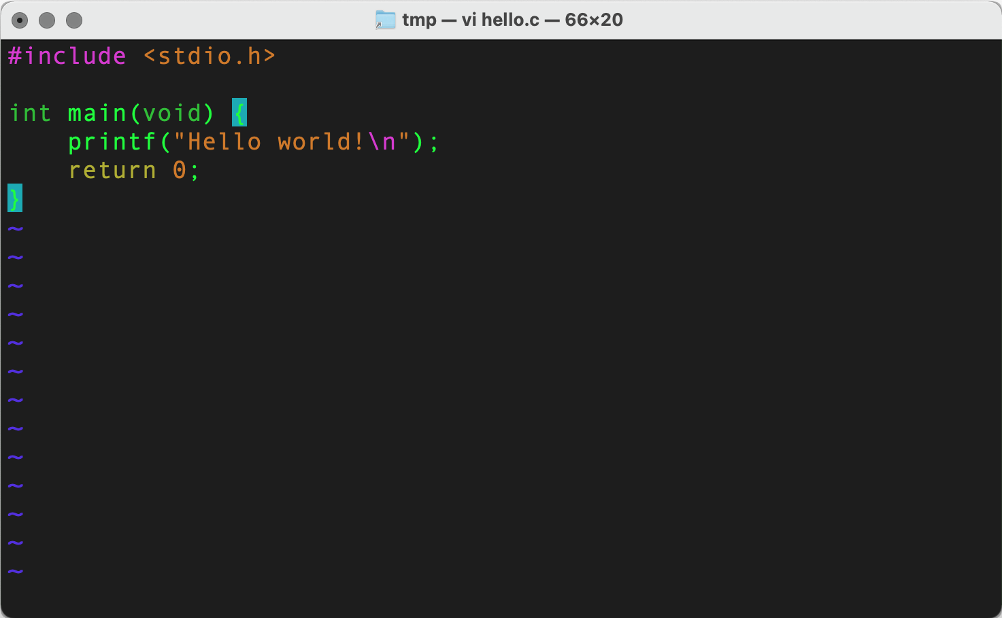
vi hello.c

Slide 18
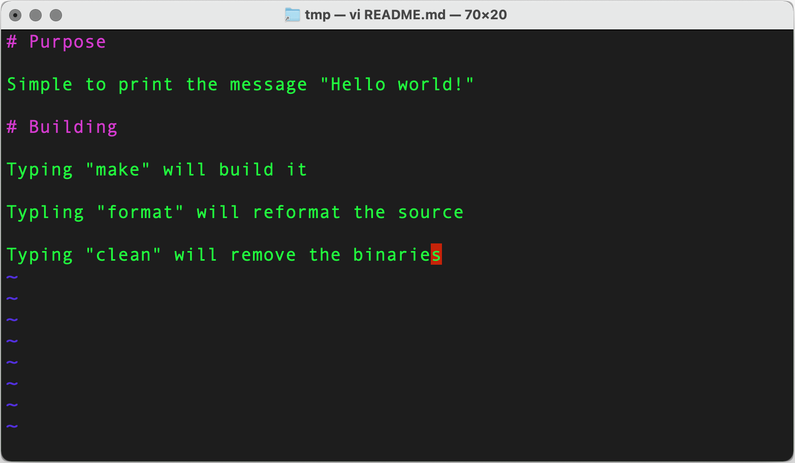
vi README.md
Oh no! A typo!

Slide 19
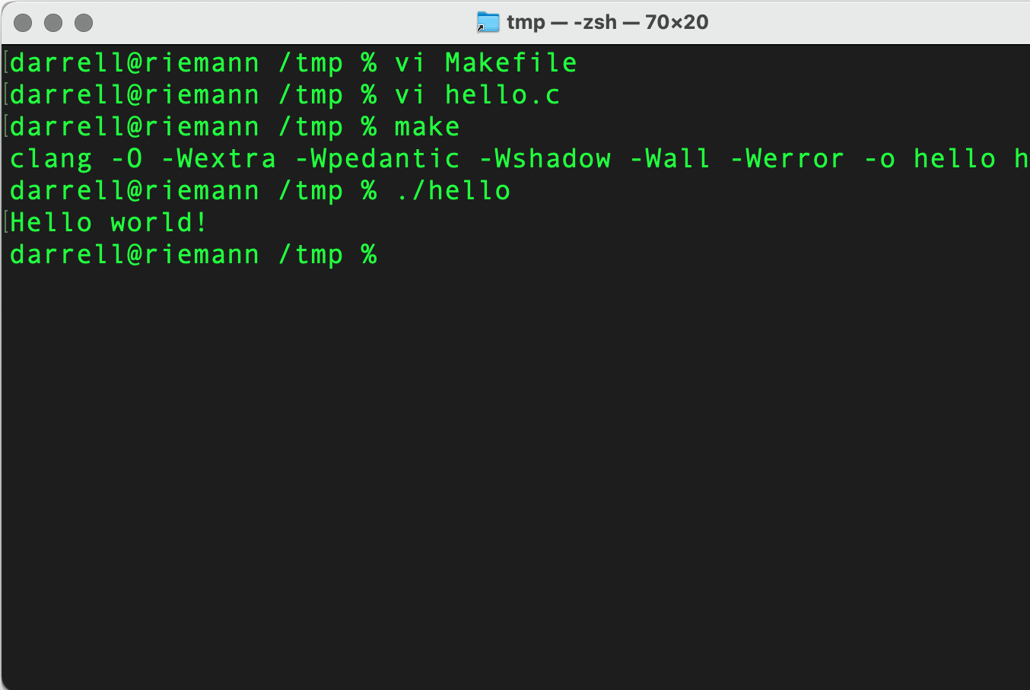
Does it work?

Slide 20
Documentation
And further, by these, my son, be admonished: of making many books there is no end; and much study is a weariness of the flesh.
—Ecclesiastes 12:12
There are two more required files:
DESIGN.pdf
WRITEUP.pdf
In this case they will both be very short, but in the future, they will be more detailed.
DESIGN.pdf
This document describes the design of your program and answers to the pre-lab questions.
It describes the algorithms and design decisions you have made.
It describes the problem that you are solving, inputs, and expected outputs.
WRITEUP.pdf
This document contains your analysis of running your program.
For example, if your assignment was to compare sorting algorithms this file would contain the results of that comparison.

Slide 21
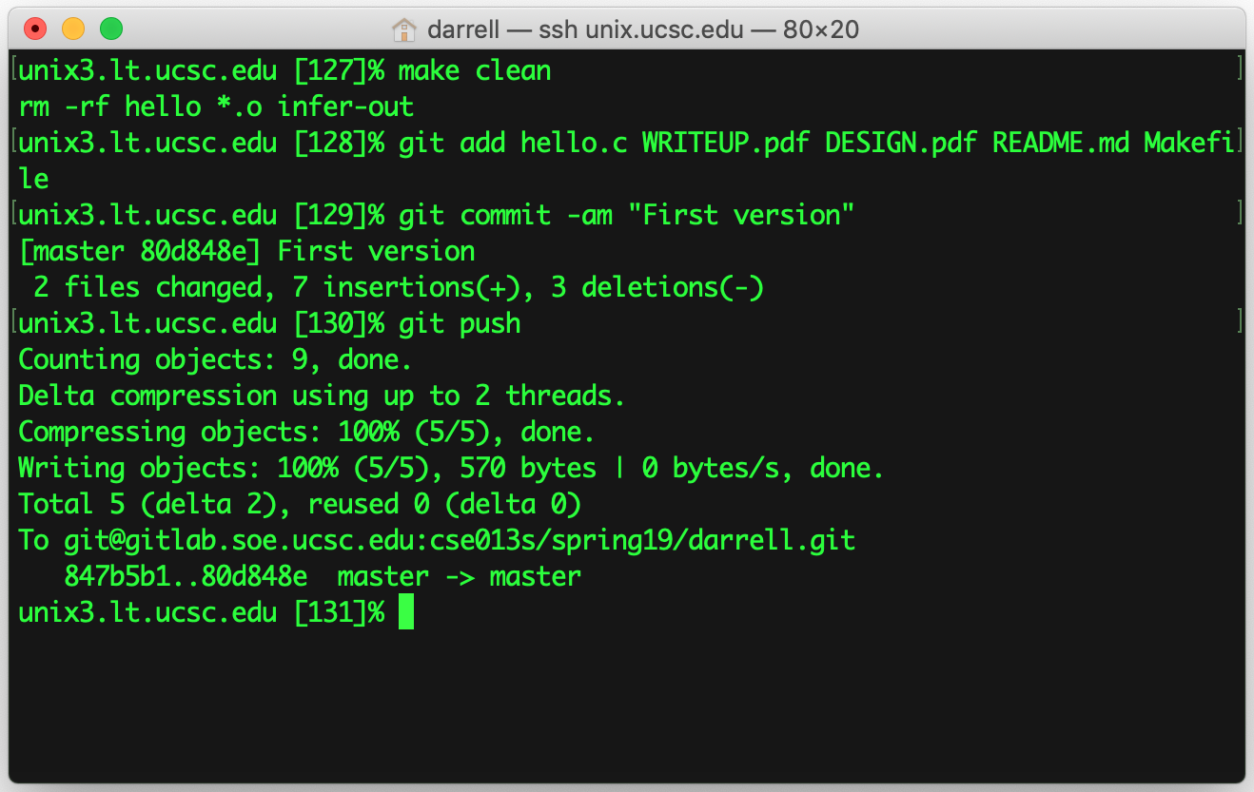
Submit using git
Add the files
Commit your changes
Push to the server

Slide 22
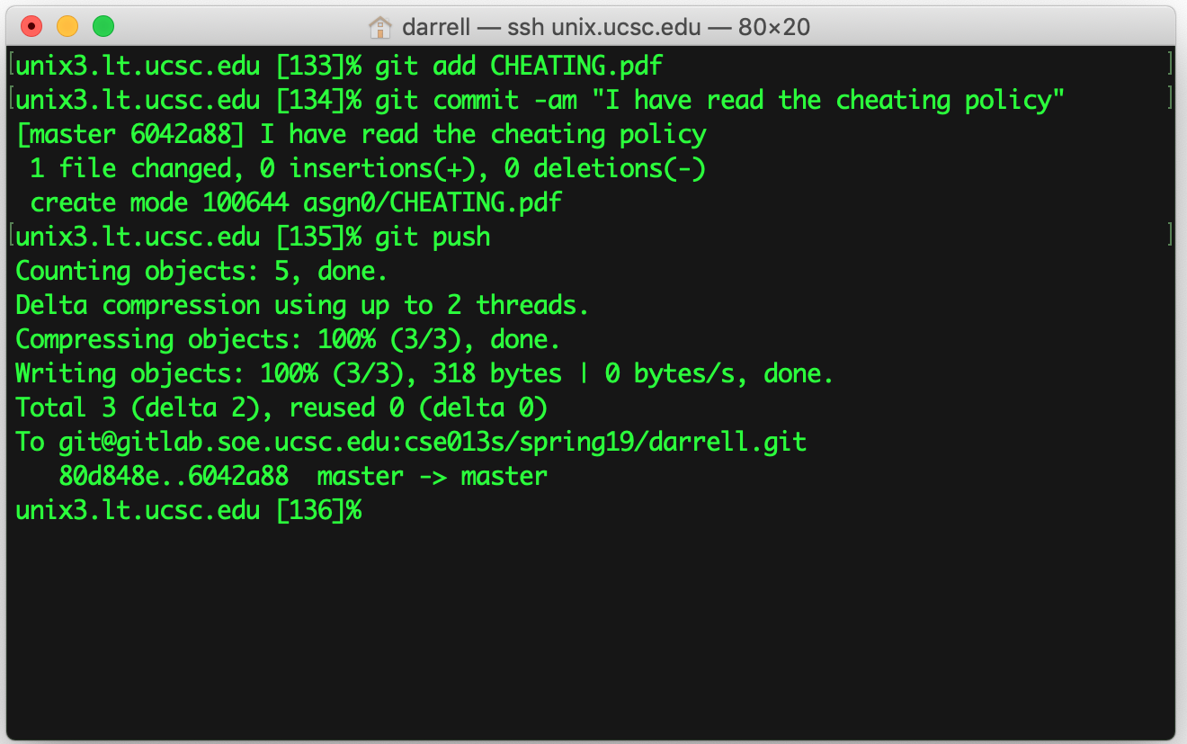
One last thing…
You must read the cheating policy.
You acknowledge having done so by submitting a PDF of the policy using git.
If you do not read and acknowledge the policy then your assignments will not be graded.
Do this once for assignment 0.

